Slide 1



Employee data analysis
STUDENT NAME : THAMIZH ANBAN.B REGISTER NO : 312215399
DEPARTMENT: ACCOUNTING AND FINANCE COLLEGE : PARICIAN COLLEGE OF ARTS AND SCIENCE

Slide 2
Project title
EMPLOYEE DATA ANALYSIS USING EXECL

Slide 3
AGENDA
PROBLEM STATEMENT
PROJRCT OVERVIEW
ENDUSERS
OUR SOLUTION AND PROPOSTION
DATASET DESCRIPTION
WOW IN OUR SOLUTION
MODELLING
RESULTS
CONCLUSION

Slide 4
PROBLEM STATEMENT
I WANT TO KNOW ABOUT THE DIFFERENCE BETWEEN MALE EMPLOYEES AND FEMALE EMPLOYEES IN AN ORGANISATION AND WANT TO KNOW ABOUT WHICH DOES THE EMPLOYEE BELONGS TO. SO I AM DOING THIS PROJECT

Slide 5
PROJECT OVERVIEW
IN THIS PROJECT I AM GOING TO FIND OUT THE DIFFERENCE BETWEEN THE NUMBER OF MALE ANS FEMALE EMPLOYEES AND FROM WHICH CITY THEY ARE COMING WITH THE HELP OF MS-EXECL AND ITS VARIOUS FUNCTIONS.

Slide 6

WHO ARE THE END USERS?

Slide 7
OUR SOLUTION AND ITS VALUE PROPOSTION
TO SOLVE MY PROBLEM I HAVE COLLECTED DATA SET OF EMPLOYEES WITH INFORMATION REGARDING GENDER, LEAVE OUT,BENCHED OUT,CITY. I WILL BE USING VARIOUS FUNCTIONS OF MS-EXECL TO FIND OUT SOLUTION.

Slide 8
DATA SET DESCRIPTION
FEATURES OF DATA SET:
1. ID
2. GENDER
3. CITY
4. BENCHED OUT
5. LEAVE OUT
6. EXPERINCED
•
THE DATA SET HAS BEEN EXTRACTED FROM KAGGLE

Slide 9
THE “WOW” IN OUR SOLUTION
FUNCTIONS AND FORMULAS
DATA ANALYZING AND VISUALIZATION
ORGANIZING AND FROMATTING WORKSHEETS
SHORTCUT AND PRODUCTIVITY TIPS
SOLVING PROBLEMS AND CHALLENGES

Slide 10
MODELLING
A)MS EXCEL:
MICROSOFT EXCEL ENABLES USERS TO FORMAT, ORGANIZE AND CALCULATE DATA IN SPREADSHEET.
B)SORTING FUNCTION:
SORTING HELPS TO ORGANISE DATA. YOU CAN SORT A TEXT COLUMN IN ALPHABETICAL ORDER(A-Z OR Z-A). WE CAN SORT A NUMERICAL FORM LARGEST TO SMALLEST OR SMALLEST TO LARGEST.
C)FILTER FUNCTIONS :
FILTER IS AN ESSENTIAL TOLL HELP TO DISPLAY RELEVENT DATA. IT ELEMINATES THE IRRELEVANT ENTRIES TEMPORARILY FROM THE VIEW.
D)KAGGLE:
KAGGLE IS A SUBSIDARY OF GOOGLE. IT IS AN ONLINE COMMUNITY OF DATA SCIENTIST AND MACHINE LEARNING ENGINEERS. IT ALLOWS USERS TO FIND THE DATASETS THEY WANT TO USE IN BUILDING AI MODELS, PUBLISH DATASETS, WORK WITH OTHER DATA SCIENTIST AND MACHINE LEARNING ENGINEERS AND ENTER COMPETITIONS TO SOLVE DATA SCIENCE CHALLENGES.

Slide 11
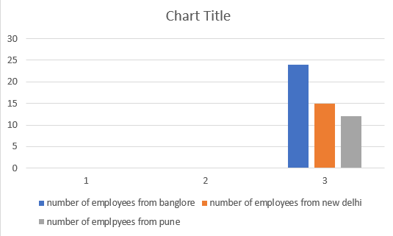
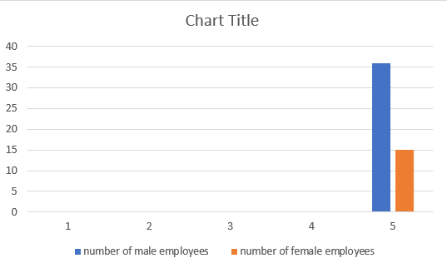
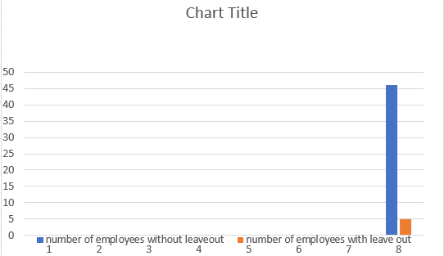
RESULT

Slide 12
CONCLUSION
I HAVE FOUND OUT THAT THERE MORE MEN EMPLOYEES THAN FEMALE EMPLOYEES, ONLY LESS EMPLOYEES BENCHED OUT AND LEAVED OUT. EMPLOYEES ARE BELONGING TO THREE DIFFERENT CITIES.

